Slide 1
Network Performance Testing Shiny Application
Nicholas Porter & Zhi Zheng

Slide 2
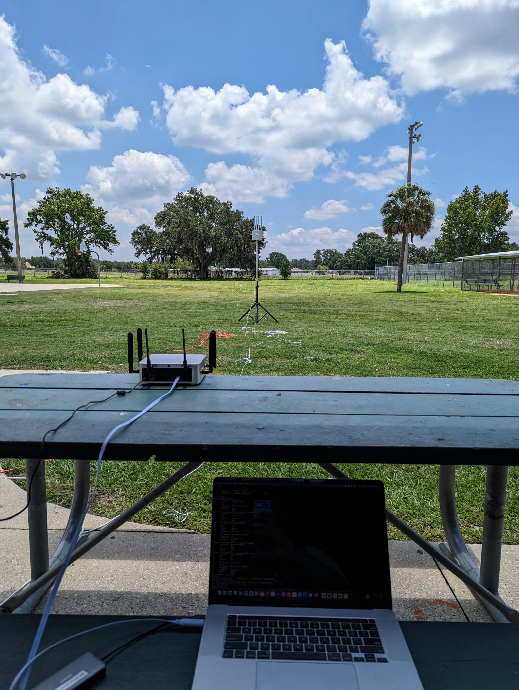
Problem Description
Network performance testing tools offer a good baseline set of data to test performance
Wrangling of this data tends to be tedious
Mostly command line based tools
Lack of standardized visualizations for observing performance across parameters.

Slide 3

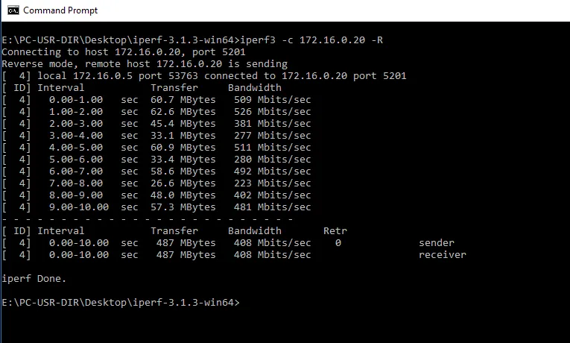
Introducing Iperf
Internet Performance Working Group
Able to track the Bandwidth between two network endpoints as well as the data transfer size for a set amount of time.
Extremely close to tabular data format, just needs to be properly collected and parsed.

Slide 4

Objective
Create an R Shiny application that is able to perform Range Distance Testing on Mesh Network Endpoints.

Slide 5
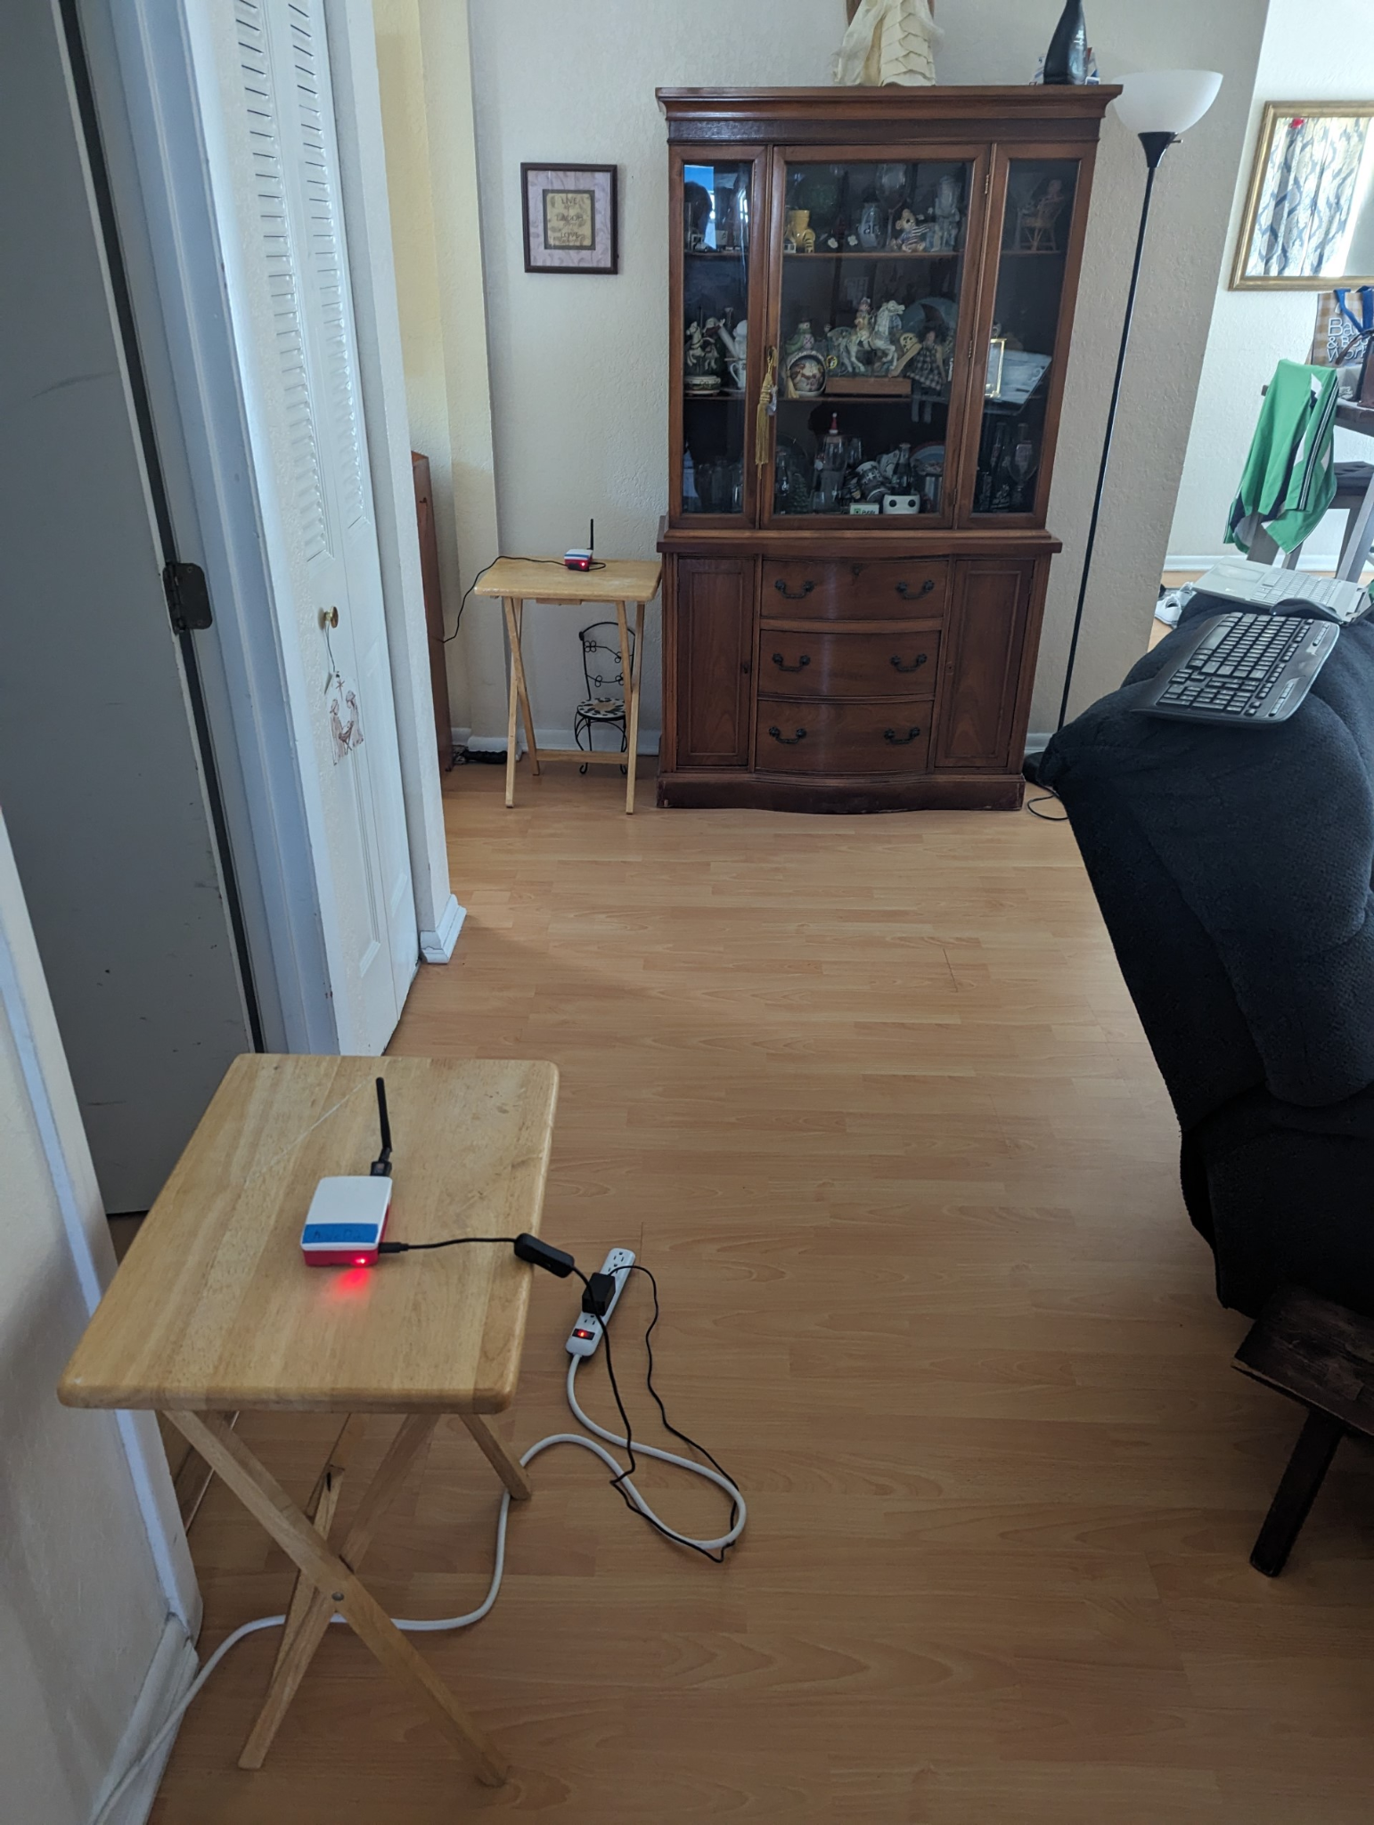
Description of Analysis
Test bandwidth speeds of data transfer between two Raspberry Pi nodes.
Compare speed across multiple distances
1 ft, 5 ft, 10 ft … 30 ft
Visualize with time series and box plot for each distance
Perform ANOVA test in order to empirically show speed difference is significant
Perform thirty ten second interval test trials at each distance

Slide 6




Methodology
FastAPI code loaded onto each Raspberry Pi which App may query with httr:
POST: Start Server, Start Test
GET: Collect testing data
Data Handling and Regex: Using Stringr to parse raw string collected from API call, and output to dataframe.
Data Summary: Summarize mean of bandwidth intervals for each trial using dplyr
Data Visualization: Generate dynamic time series and box plots using ggplot.

Slide 7
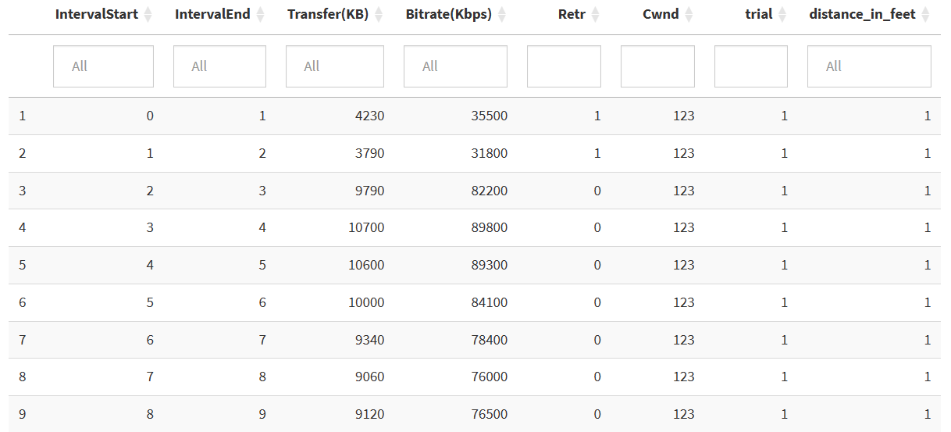
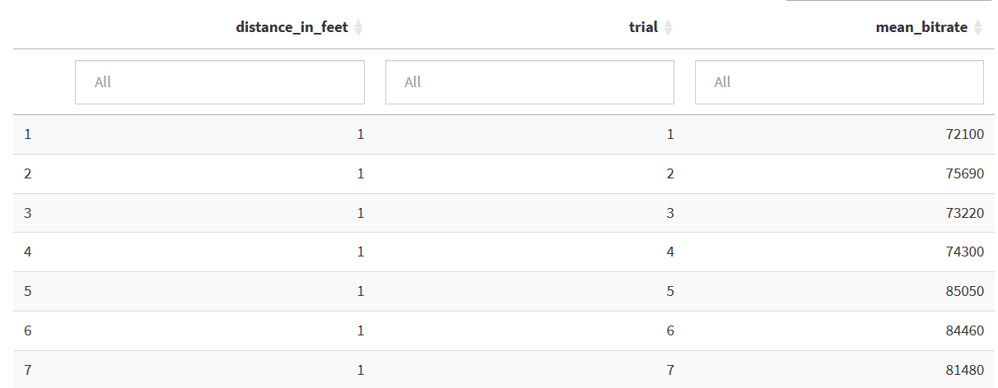
Methodology
Modularization: Application structured in distinct, manageable modules.
Interactive Filtering: Enables data filtering by trial range or network metrics.
File Upload: Direct upload of csv files with Iperf test results from previous sessions.
Other libraries:
DT
Shiny Themes
Shiny Widgets

Slide 8
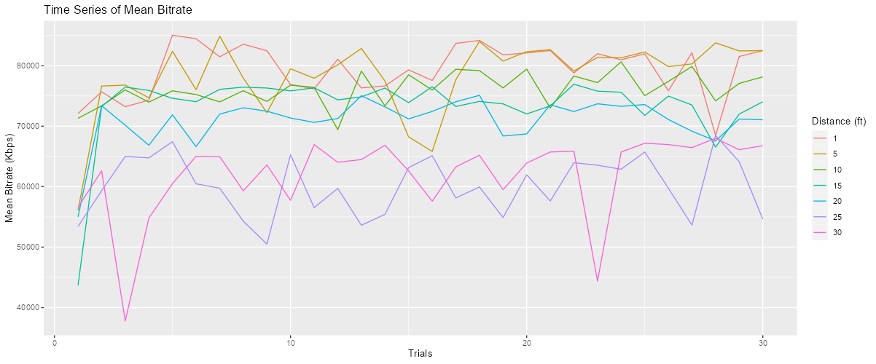
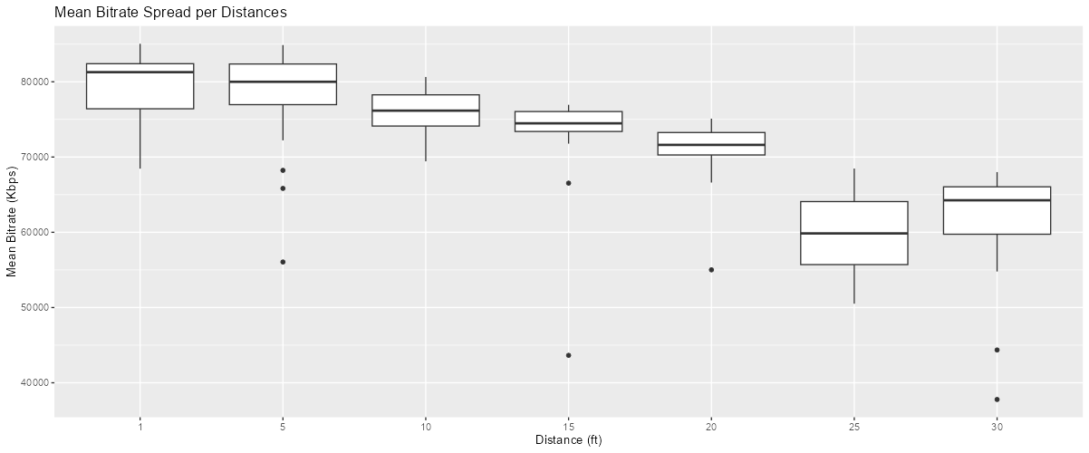
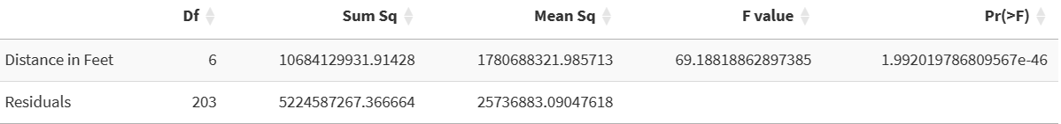
Results and Discussion
Bandwidth significantly decreased as distance increased as expected.
Outliers in visualization demonstrate packet loss. Causes?
Tumultuous nature of Wi-Fi transfer
Somebody walked between the nodes
Future work:
Different data transfer sizes
Compare TCP against UDP

Slide 9
Video Demonstration
https://drive.google.com/file/d/17v4GwUenMMcLxQ_4NZgZqZobyKvzpSzX/view?usp=sharing

